Slide 1
NAR Advocacy & Policy Resources
Christie DeSanctis, Federal Banking, Lending & Housing Finance Policy Director
Melissa Horn, State and Local Policy Representative
NATIONAL ASSOCIATION OF REALTORS®

Slide 2
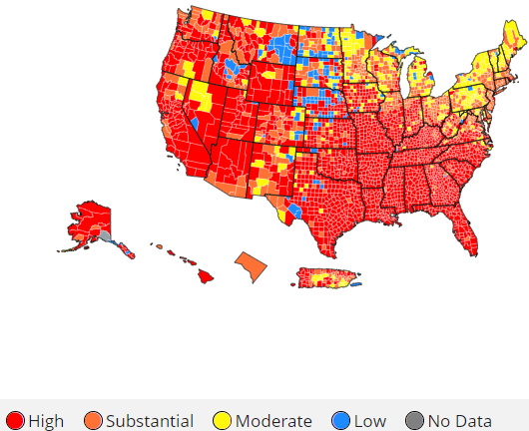
AUGUST 3, 2021 – CDC REIMPOSES EVICTION MORATORIUM
Effective August 3, 2021, through October 3, 2021, for areas of the country with “heightened levels of community transmission.”
The moratorium is based on the level of COVID infection in a given county as tracked by the CDC.
Moratorium can only be lifted if an area no longer experiences substantial or high (orange or red) rates of transmission for two weeks.
Moratorium can be reinstated if an area returns to a high-risk designation.
The order is not retroactive and does not replace stricter moratoriums already in place by state and locals.
Each state/locality has different judicial eviction procedures in place and many may not be impacted by the expiration of the order on July 31st or the new order effective August 3rd.
While set to expire on Oct. 3, the order “is subject to further extension, modification, or recission, based on public health circumstances.”

Slide 3
CDC EVICTION MORATORIUM HISTORY
SCOTUS RULING: June 29, 2021
Congress Enacts: March – July
2020
Congress Extends: Dec. 2020 – Jan. 2021
CDC Extends: Jan. – March
2021
CDC Issues Order: Sept. – Dec. 2020
CDC Extends: March – June
2021
CDC Extends: June –
July
2021
CDC Issues NEW Order:
Aug. 3 –
Oct. 3
2021
Ongoing Litigation: May 5, 2021 – D.C. District Court decision in favor of plaintiffs; DOJ appealed to D.C. Circuit, motion still pending.
Alabama Association of REALTORS®, Georgia Association of REALTORS®, et al. v. HHS, et al. (U.S. Dist. Ct. D.C., Case No. 1:20-cv-03377-DLF, filed November 20, 2020).

Slide 4
LITIGATION OPTIONS UNDER CONSIDERATION
Why not the Supreme Court?
The time to seek reconsideration has expired, thus the Court requires plaintiffs to first seek relief in the lower courts.
Why the district court?
Judge Friedrich still has jurisdiction to enforce her judgment, even though the case is on appeal.
What about a class action suit for damages?
NAR is considering all legal options and no decisions have been made at this time.

Slide 5
OTHER ADMINISTRATIVE/CONGRESSIONAL ACTIONS
Details for Renters/Housing Providers:
On July 30, 2021, the Department of Housing and Urban Development (HUD) released a notice outlining multifamily landlords’ obligations under forbearance on HUD-owned or HUD-insured properties.
Under that guidance, if forbearance is taken on that property, the landlord cannot evict a renter for non-payment while the property is in forbearance. After forbearance, the landlord must provide 30-days’ notice.
On July 30, 2021, the Federal Housing Finance Agency (FHFA) released a statement encouraging landlords of properties backed by Fannie Mae and Freddie Mac to apply for the Federal Emergency Rental Assistance Program (ERAP) before starting any eviction processes.
On July 28, 2021, the FHFA announced that it would require 30-day notice be given to renters for eviction. This applies to all GSE-backed loans, not just those in forbearance.
See also FHFA’s Fact Sheet on Tenant Protections for GSE-backed rental properties.
On July 28, 2021, the Consumer Financial Protection Bureau (CFPB) released a new toolkit for tenants and housing providers to access rental assistance and for organizations to help spread the word on these resources.
Effective May 3, 2021, the CFPB issued an interim final rule under the Fair Debt Collection Practices Act (FDCPA) that requires debt collectors seeking eviction for nonpayment of rent to provide clear and conspicuous written notice to tenants of their rights under the CDC’s eviction moratorium.
Servicers must also ensure that several safeguards are met before proceeding with a foreclosure.
Details for Homeowners:
On July 30, 2021, the FHFA announced that Fannie Mae and Freddie Mac would extend their moratorium on single-family real estate owned (REO) evictions until September 30, 2021.
This includes REOs taken by foreclosure or deed-in-lieu of foreclosure.
On July 30, 2021, HUD, FHFA, the Department of Agriculture (USDA), and the Department of Veterans Affairs (VA) announced their extension of their foreclosure-related eviction moratoria until September 30, 2021.
See the VA’s website to help tenants avoid eviction.
See the FHA’s extension notice for foreclosed borrowers and other occupants.

Slide 6
NAR ADVOCACY
“About half of all housing providers are mom-and-pop operators, and without rental income, they cannot pay their own bills or maintain their properties.
NAR has always advocated the best solution for all parties was rental assistance paid directly to housing providers to cover the rent and utilities of any vulnerable tenants during the pandemic. No housing provider wants to evict a tenant and considers it only as a last resort.
"Rental assistance is now available in every state to cover up to a year-and-a-half of back and future bills," . "It's time to put our full efforts behind its deployment so that the housing market can return to its former, healthy function."
– NAR 2021 President Charlie Oppler

Slide 7
STATE AND LOCAL POLICY RESOURCES
State & Local Policy Representative,
National Association of REALTORS®

Slide 8
STATE & LOCAL POLICY STATEMENTS
The following state and local issues policy statements have been adopted by the National Association of REALTORS® (NAR) Board of Directors. All policy statements have been put forth, reviewed and approved by REALTOR® members serving on the State and Local Issues Policy Committee.
ASSESSMENT PRACTICES
BROWNFIELDS AND LOCAL TAX INCENTIVES
COMMUNITY OUTREACH, DEVELOPMENT & REVITALIZATION
CONFISCATION OF REAL PROPERTY
EMINENT DOMAIN FOR MORTGAGES
FIRST-TIME HOMEBUYERS SAVINGS ACCOUNTS
GENERAL STATEMENT ON HOUSING POLICY
IMPACT FEES
LAND USE & GROWTH MANAGEMENT
MEMBER INVOLVEMENT
POSSESSION AND EVICTION
PRIVATE TRANSFER FEES
13. PROPERTY RIGHTS
14. PUBLIC EDUCATION
15. RENT CONTROL
16. RENTAL HOUSING
17. SALES TAX ON REAL ESTATE SERVICES
18. SIGN ORDINANCES
19. STATE AND LOCAL TAX SPENDING LIMITATION
20. TAX EXEMPT PROPERTIES
21. TRANSFER TAXES
22. TRANSPORTATION
23. WATER RESOURCES
*Note that some Federal Policy Statements may apply to State and Local issues. Federal Policy Statements cover Appraisal & Valuation, Business, Commercial, Diversity and Fair Housing, Environmental and Property Rights, Federal Housing, Federal Tax, Financial and Credit, Foreclosures, Immigration, Insurance, Real Estate Transaction Procedures and Fees, Right of Ownership, Technology, and Transportation Issues. These can be found at https://www.nar.realtor/political-advocacy/federal-advocacy/all-federal-issues

Slide 9
WHAT IS NAR’S POLICY ON EVICTIONS?
POSSESSION AND EVICTION
The National Association of REALTORS® (NAR) believes that the fundamental right of rental property owners to regain possession of their property shall not be abridged.
NAR opposes the erosion of these property owner rights:
The right to owner-occupied property.
The right to inspect property with proper notice.
The right to terminate tenancy within the terms of the lease.
The right to freely go out of the rental business and convert property to other uses.
There shall be no requirement to pay tenant relocation fees.
Adopted, 2017. Reaffirmed, 2019.

Slide 10
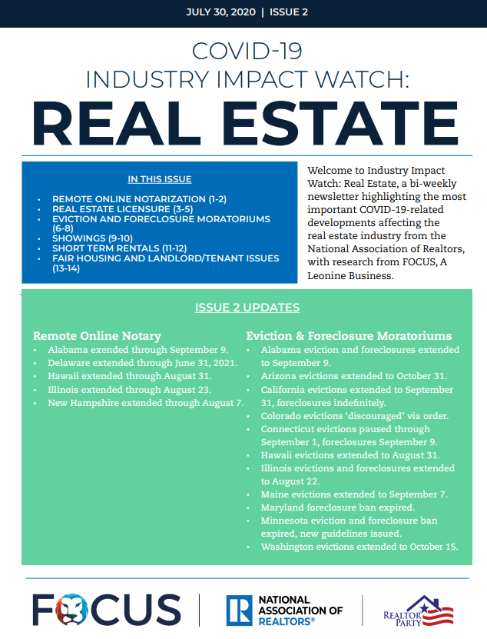
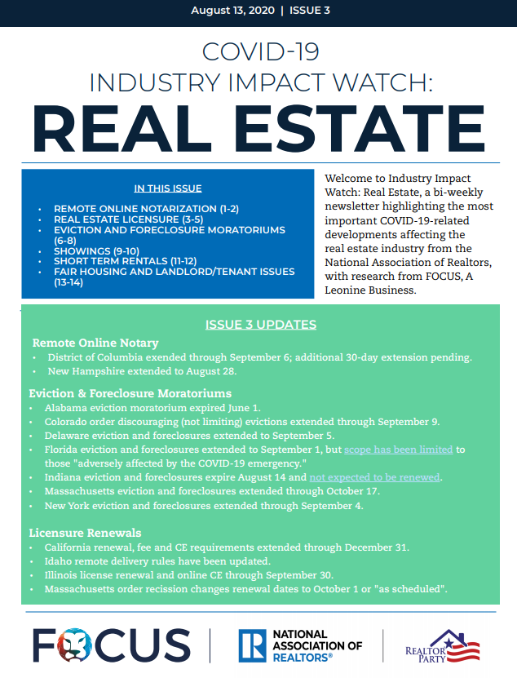
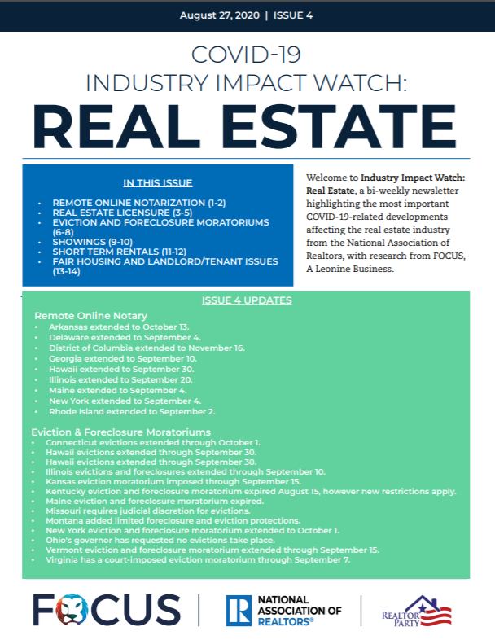
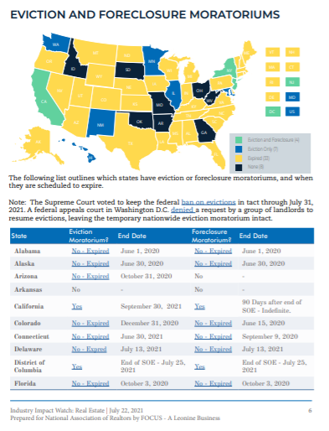
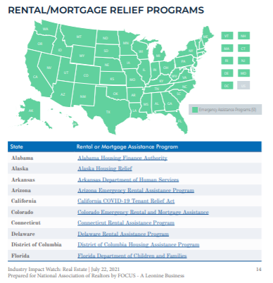
DO WE TRACK POLICY ACTIVITY ON THESE ISSUES?
Issues Covered:
Eviction and Foreclosure Moratoriums
Rental and Mortgage Relief Programs
Fair Housing
Short Term Rentals
Licensure (including changes to prelicensing, post-licensing and continuing education and examination procedures and requirements)
Electronic Notarization

Slide 11
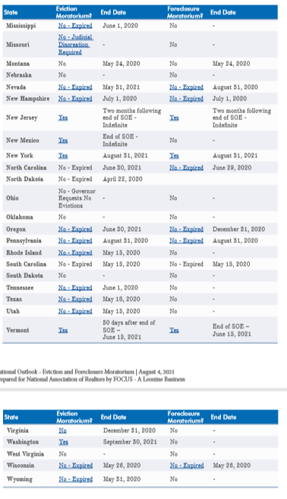
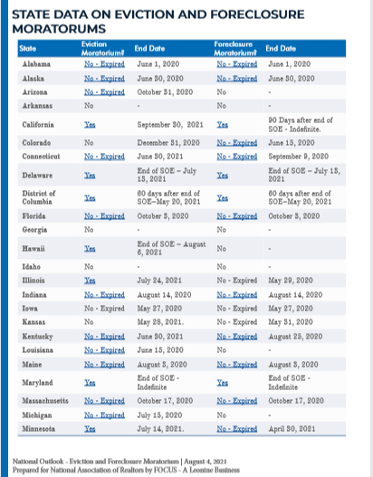
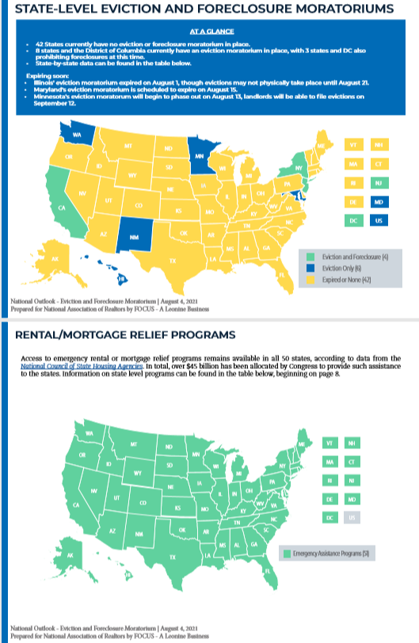
SPECIAL EDITION RELEASED TODAY
Text
EVICTIONS
to 30644
https://realtorparty.realtor/state-local-issues/resources/state-local-coronavirus-resources

Slide 12
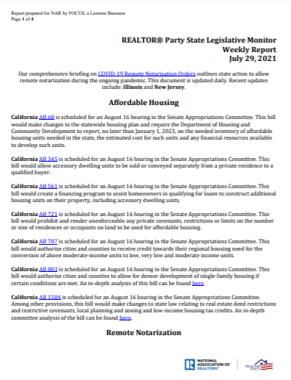
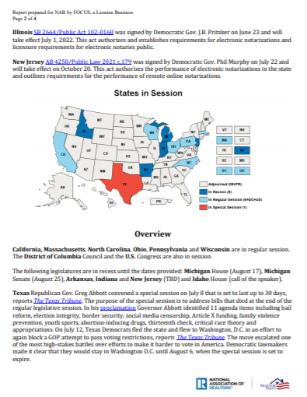
STATE LEGISLATIVE
MONITOR
Released on Thursdays weekly
Covers Trending State Legislative Topics
Affordable Housing, Inclusionary Zoning, Association Health Plans, Blockchain, Closings, Government Assistance Programs, Paid Leave, Insurance, Environment/Energy/Green Initiatives, Land Use and Growth Management, Housing Supply, Home Buyer Programs, Tax Deductions, HOAs, Landlord/Tenant, Service Animals, Rent Control, Net Neutrality, Notaries, Opportunity Zones, Preemption, Licensing, Inspections, Education, Rental Restrictions, Short-Term Rentals, Disclosures, Smart Technology, Property Taxes/Other Taxation, Mortgage Recordation Fees
realtorparty.realtor/state-local-issues/resources/
state-legislative-monitor

Slide 13
OTHER NAR RESOURCES TO SUPPORT STATE & LOCAL REALTOR® ASSOCIATIONS
As dialogue shifts to greater focus on the state and local governments, REALTOR® Associations can utilize NAR advocacy programs like Issues Mobilization to map out campaign strategies and NAR’s Call for Action platform, Advocacy Everywhere.
Text
EVICTIONS
to 30644

Slide 14
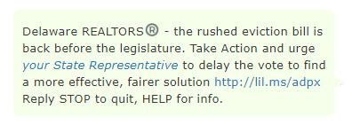
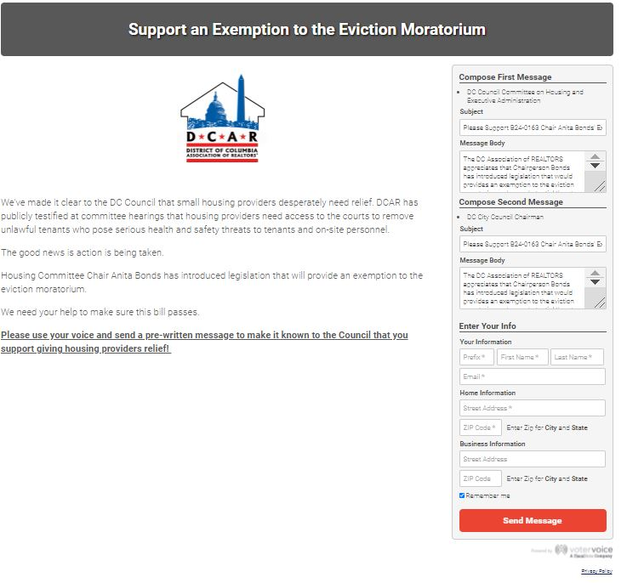
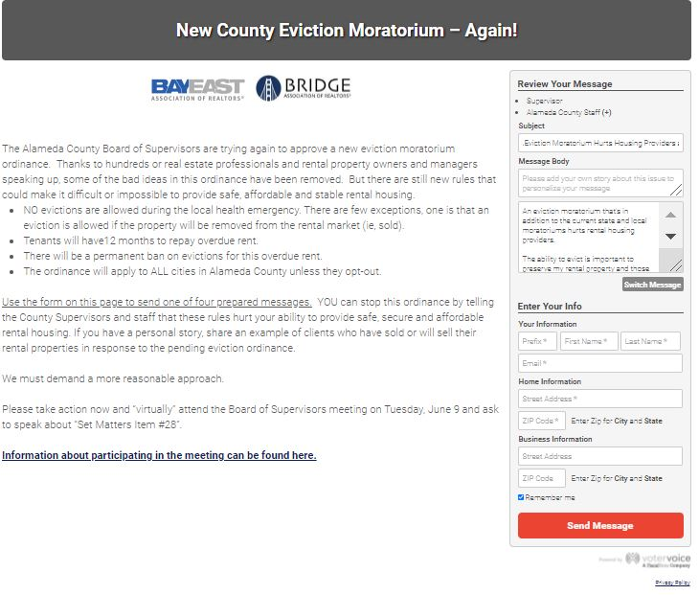
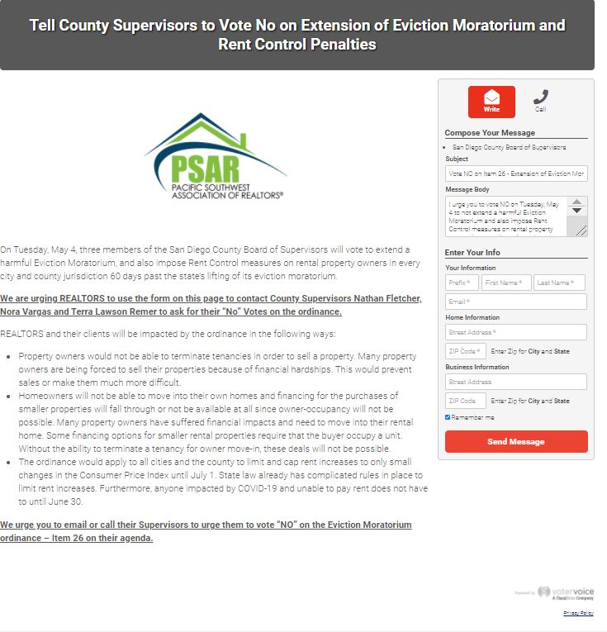
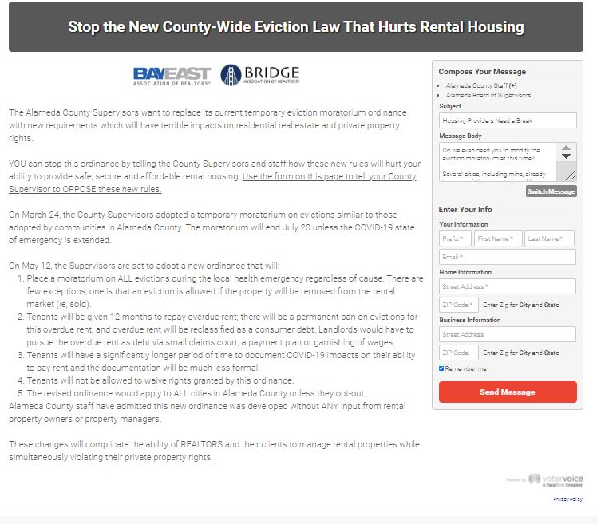
Like every policy issue, REALTOR® engagement is key!

